Slide 1
Version Control – The Git Way
Git is a version of version control
Ben Schwarz

Slide 2
Working in a team
When you write code, you want to be able to share it with other people on your team who you are working with. How can I do this?
Do we just use google drive or like a USB?
All of these are archaic solutions to this problem.
The actual solution: Enter Version Control and Git
Before we take a practical exploration of Git – we first need an explanation as to the theory.

Slide 3

What is Version Control?
Version Control: Any system that allows you to understand the history of the file and how it has progressed.
The version control system we use is Git, which was created by the same person who made Linux. Git is known as a Distributed version control system (DVCS).
If you are anything like me you have a version control system for assessments consisting of:
Assessment Draft
Assessment
Assessment final
Assessment FINAL
Assessment FINAL v2
Does anyone see a problem with this?

Slide 4

The Repository
The repository is the location where a version control system keeps track of all changes that are made.
Think of the repository like a bank vault and the repository’s history like the ledger. Each time a deposit – known as a commit is made, Git adds an entry to the ledger and stored the changes for safekeeping.
And does Mr Harry Potter have his key?

Slide 5
Your own private repository
In a DVCs – each user has their own private repository on their computer – the Local Repository. This repository stores the entire history of changes. You commit your changes to this repository.
Commit: An annotated “snapshot” of the differences made to the system at a given point in time.

Slide 6
What do we store in a repository?
Nearly everything that you need to work on your project.
Your repository needs a copy of everything in your project that is essential for you to modify, enhance and create new versions of it.
You should store your project’s source code and the build files it requires.
Other common items are sample configuration files, documentation, images used in the application and unit tests.
However: you shouldn’t include the tools you use like eclipse, and stuff specific to your computer.

Slide 7
Working Trees
The working tree is your current view of the repository. It is the current version that you are editing and working on.
The rest of the repository exists in the .git/ directory inside your project’s directory on your computer.

Slide 8
Manipulating Files and Staying in Sync
Committing a change adds a new revision to the repository, and stores a log message explaining what the change did. This log provides a record to help you identify where you made changes earlier.
However this repository you commit to is stored on your computer. Once you want to share with the rest of your programmers you push your commits to an upstream repository.
This is a repository which is not on your computer that you and other developers push changes to.

Slide 9
Retrieving From an upstream Repository:
First you ‘fetch’ from an upstream repository, which syncs the upstream repository with the repository stored on your computer. Then you merge those changes into your local history (your working tree).
Git provides a useful tool to do both of these at once known as pulling.
Since Git is fully distributed, you can push and pull changes to multiple repositories (However, in your time on our team you will most likely only pull from one).

Slide 10
Tracking Projects, Directories, and Files
At the lowest level Git tracks the content – being the individual characters, lines, methods and classes that make up each file.
This reduces the amount of storage space needed to keep the entire repository.
Allows git to determine if classes or functions have moved between classes or where copied code came from.

Slide 11
Programming Workflow
Fetch Changes from Team
Make Changed & Commit Them (repeat until done)
Review Commits
Share Changes with the Team

Slide 12
There is far… far… more to Git – wherein most of the usefulness lies, but for now installing…
Install Git on your Computer: https://git-scm.com/downloads
You should see the Git Setup wizard screen.
Follow the Next and Finish prompts to complete the installation.
Suggested – use Git Bash as main command prompt for Git. (very colourful)
Configuring Git
Open git bash and type in the following commands
$ git config --global user.name “Mr Potato”
$ git config --global user.email “mr@potato.com”
To check your setup: $ git config –list
2. Create a Github Account (Github is the remote repository we use). Advice: Do not use your school email as you are likely going to want to use this account after you finish school.

Slide 13
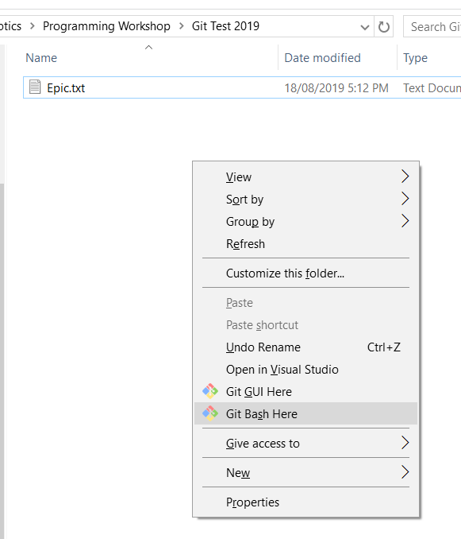
Lets Start a Repository
Somewhere in your documents create a folder and a text file with a message inside.
In this folder right-click and select open git-bash

Slide 14
Setting up Repository
Creating Repository:
$ git init
Checking status of Repository:
$ git status

Slide 15
Staging Changes to Commit
Git uses a two-step process to put changes into your private repository.
First you stage changes by using $git add
Staging a change adds it to the index, or staging area. This sits between the working tree – your view of the repository and the actual repository.
You can control what is placed into the staging area from files down to individual lines.
Useful commands:
$git add <file> (Adds specific file to staging area)
$git add --all (Adds all files to staging area)

Slide 16
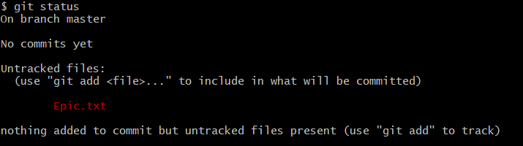
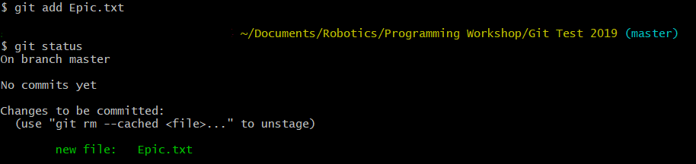
What this should look like
MrPotato@PotatoBox WINGDING64

Slide 17
Actually Committing
Command | Result
git commit –m “Helpful description of changes” | Commits staged changes with a description
git commit | Commits staged changes but opens your set editor to write the commit message.
git commit –m “Helpful description of changes” -a | The –a takes everything from your working tree being tracked and commits it (regardless of if it has been staged)
git commit –m “Helpful description of changes” some-file | Commits a specified file from the working tree regardless of what has been staged.

Slide 18
Ignoring Files – Git ignore
Some types of files you don’t want to commit (like compiled code). There is a list of files and file types which git will ignore called the .gitignore file.
When deciding if you do not wish to commit certain files, consider if this file is required in order to use the repository, or if it is different on everyone’s computers.
Always consult with a senior programmer before adding or removing files from a .gitignore

Slide 19
Branches
Sometimes we want to do many things at once.
E.g. develop new features while having a stable build we can use.
Having one copy of code makes this challenging.
A branch is a diverging path. A branch can be created at a point in the repositories history, and then changes can be made on this branch and then merged back into the master branch.

Slide 20
Branches - Continued
Everything in git is treated like a branch. The main branch by default is called the master branch.
Git branches keep track of the most recent commit in the branch, and they have a link to their parent commit. Git can use this to work out the history of every branch.
When do we use branches?
Short Answer: Always
Longer Answer: On the team we have the master branch as the branch guaranteed to always work. This means if we need to run the robot we could push code from this branch to the robot, and it should be in a state where the drivers can use the robot.
Everything else is done in separate branches.
Branch names describe the feature and purpose. Example: elevator-PID-Tuning.

Slide 21

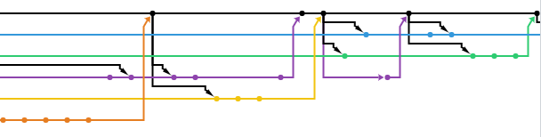
Branches in action

Slide 22
Branches Commands
Command | Function
git branch | Lists all branches. The current active branch will be listed as * branch-name. For example - * master
git branch “branchname” | Creates a branch from the current checkedout Branch
git checkout “branchname” | Changes the branch being viewed and edited to the listed branch.
git branch “newbranchname” “oldbranchname” | Creates a new branch from a specified branch – not necessarily the current branch.
git branch -b “newbranchname” “oldbranchname” | Creates a new branch and switches to it.
git branch –d “branchname” | Deletes the branch
git branch –m “oldbranchname” “newbranchname” | Renames a branch. Won’t override pre-existing branches.
git checkout “commitId” | Checks out a specific commit.
git branch -r | Lists all remote branches

Slide 23
Merging
Merges one branch into another branch.
Straight merges: takes the history of one branch and history of another and attempts to merge them together.
Squashed commits: takes the history of one branch and compresses it into a single commit which is merged into a different branch.
Cherry-picking: Pulls a single commit from one branch and applies those changes to the current branch.

Slide 24
Merge Commands
Command | Purpose
git merge “branchname” | Merges branchname into current branch
git merge --squash “branchname” | Squashes listed branch into one commit which is merged into current branch.
git cherry-pick “commitID” | Cherrypicks specific changes from that commitId into the current branch.
Important: For Merging into Master – Pull Requests are essential (If this is a Team Repository).

Slide 25
Remotes - Github
So far we have looked at using only your local repository.
To work with other people, you want to push and pull your changes to a remote repository (a repository not on your computer).
We use Github

Slide 26
Cloning:
git clone serveraddress
E.g. git clone https://github.com/B-e-n-S/TestRepo.git
Using the https address is easier to set up then SSH.

Slide 27
Adding New Remotes
Origin is the default remote repository.
git remote add origin severAddress
git remote add “name” severAddress - Adds remote repository under a shortened name if you want to add additional remote repositories.

Slide 28
Fetch, Pull & Push
Command | Purpose
git fetch | Fetches changes from your remotes and updates your remote branches. These are considered separate to git commits. In order to see these changes you need to merge them into your local branches.
git push | Pushes working tree of current branch to remote branch counter-part. (If there isn’t one it will publish a new branch on the remote.
git pull “remoteRepository” “branch” | Fetches changes from a remote repository and merges specified branch into your local repository.
Complete documentation on git push -https://git-scm.com/docs/git-push

Slide 29
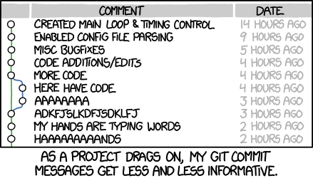
Styling Conventions
Single line, descriptive commit message
Past tense – added, changed, removed
Thing that changed
Optionally, reason for change
Second line can be used for extra description of change, but not for a second change
Minor fixes -> Fixed [thing that was fixed]
Style fixes -> Corrected code style in
[file or section]

Slide 30
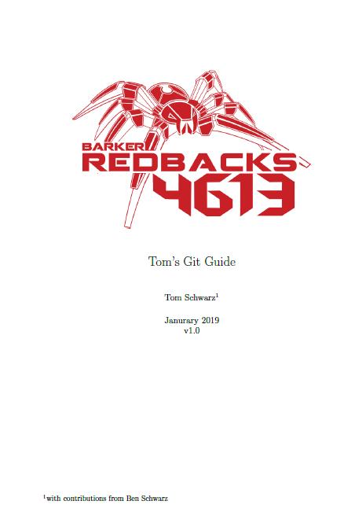
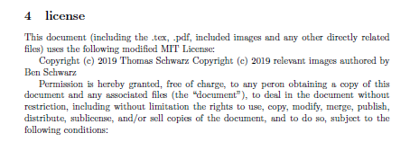
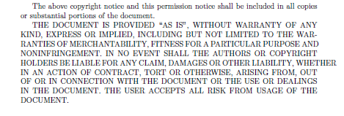
From here on the rest of the PowerPoint consists of screenshots from the following guide.
It is encouraged that you open and read this instead.

Slide 31
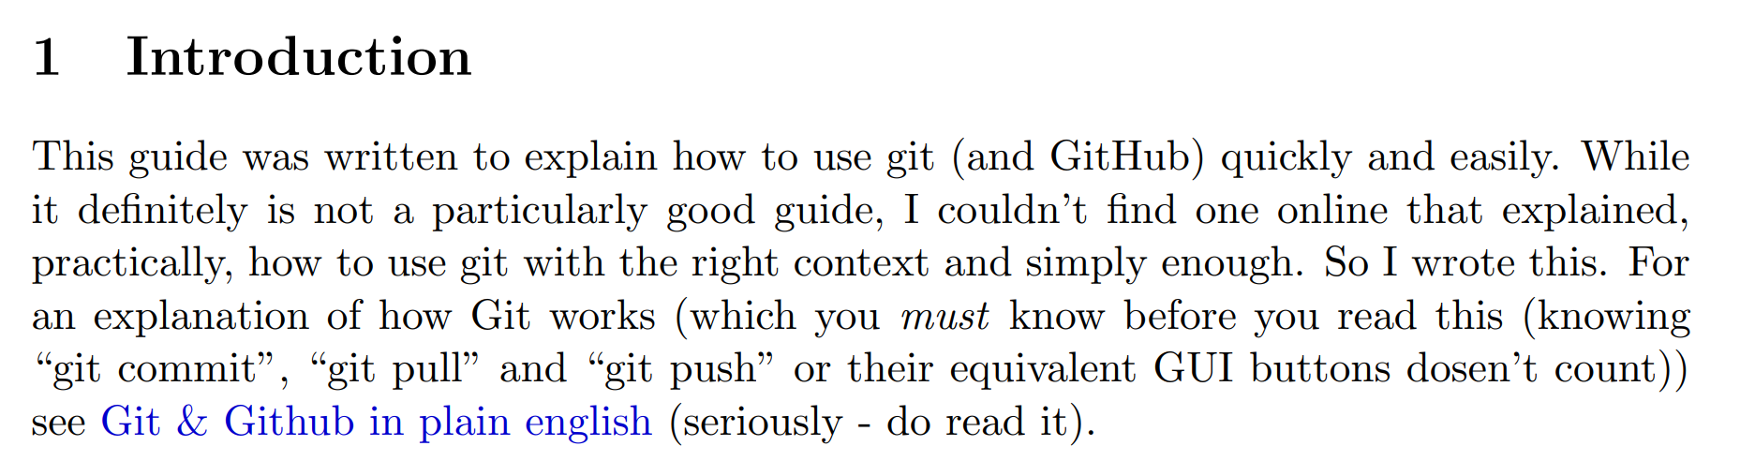

Slide 32
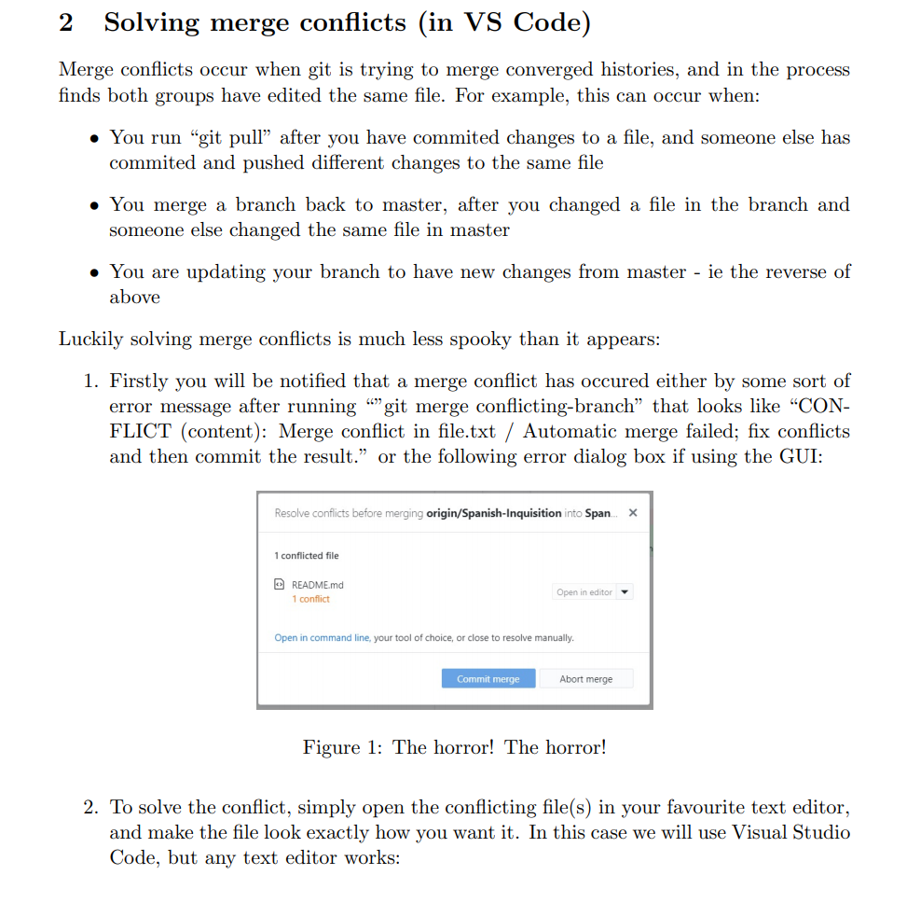

Slide 33
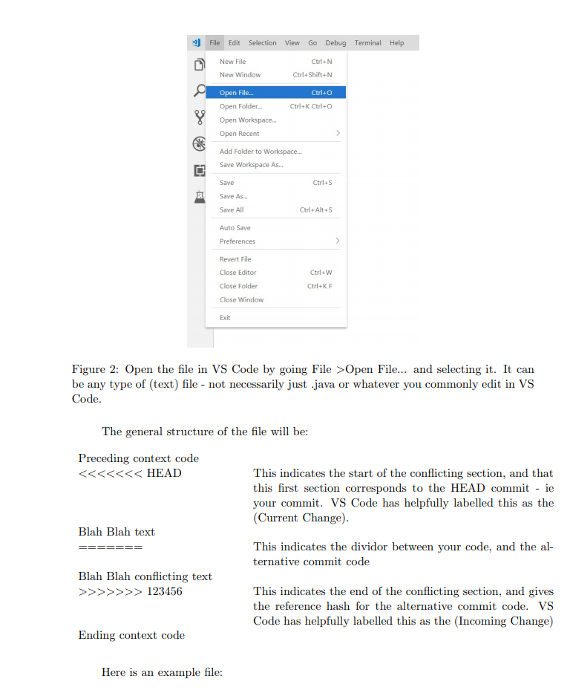

Slide 34
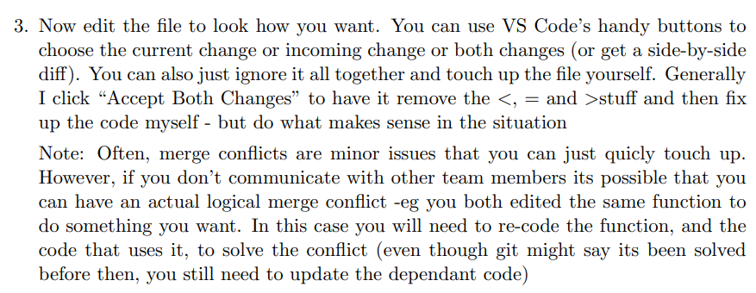
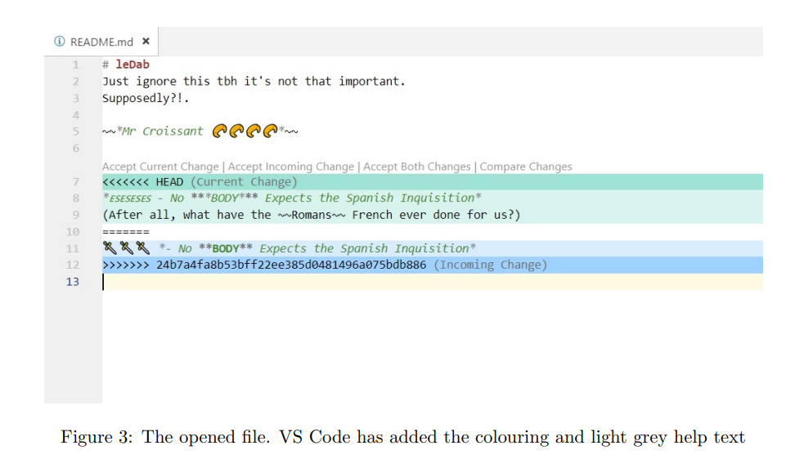

Slide 35
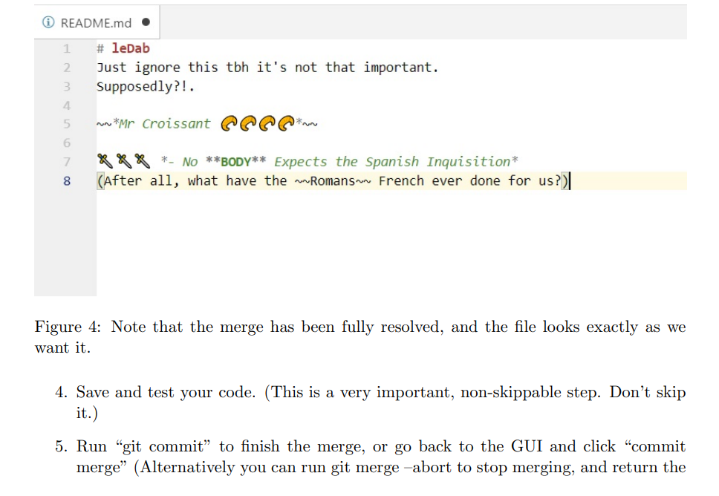


Slide 36
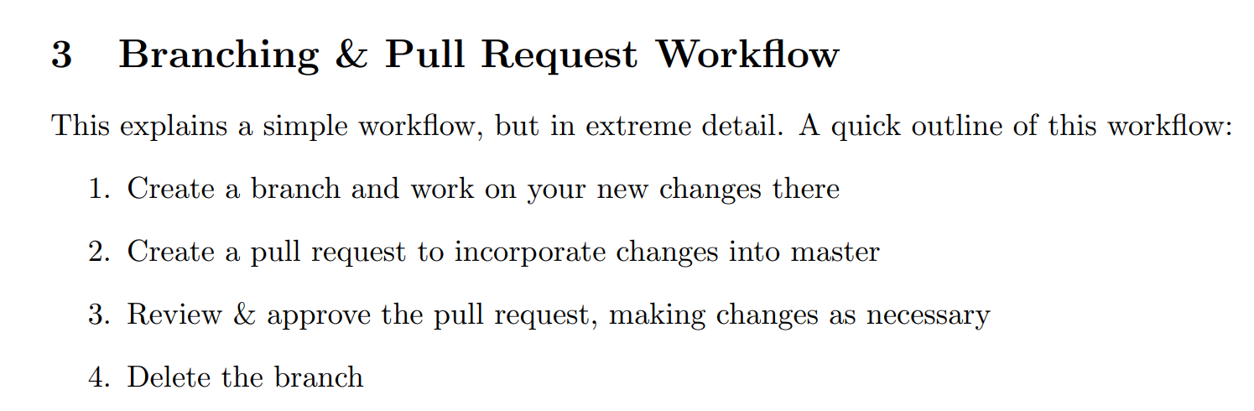

Slide 37
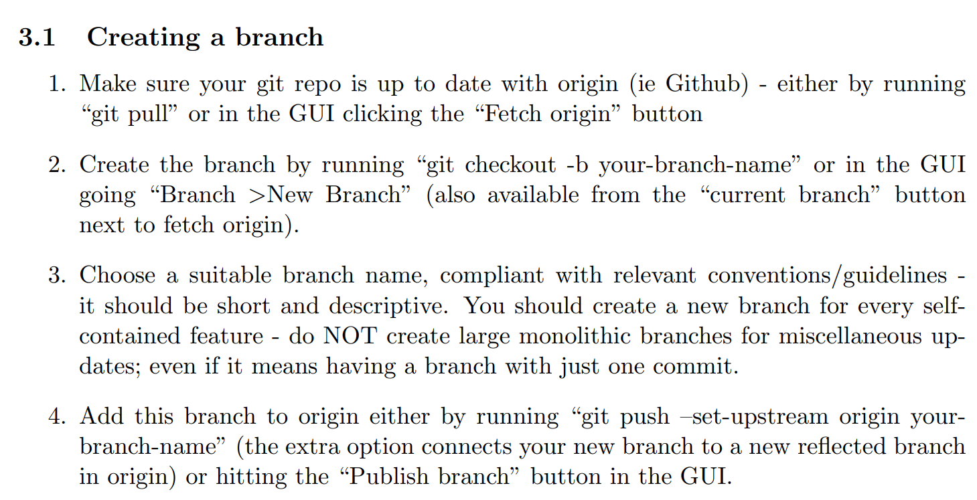
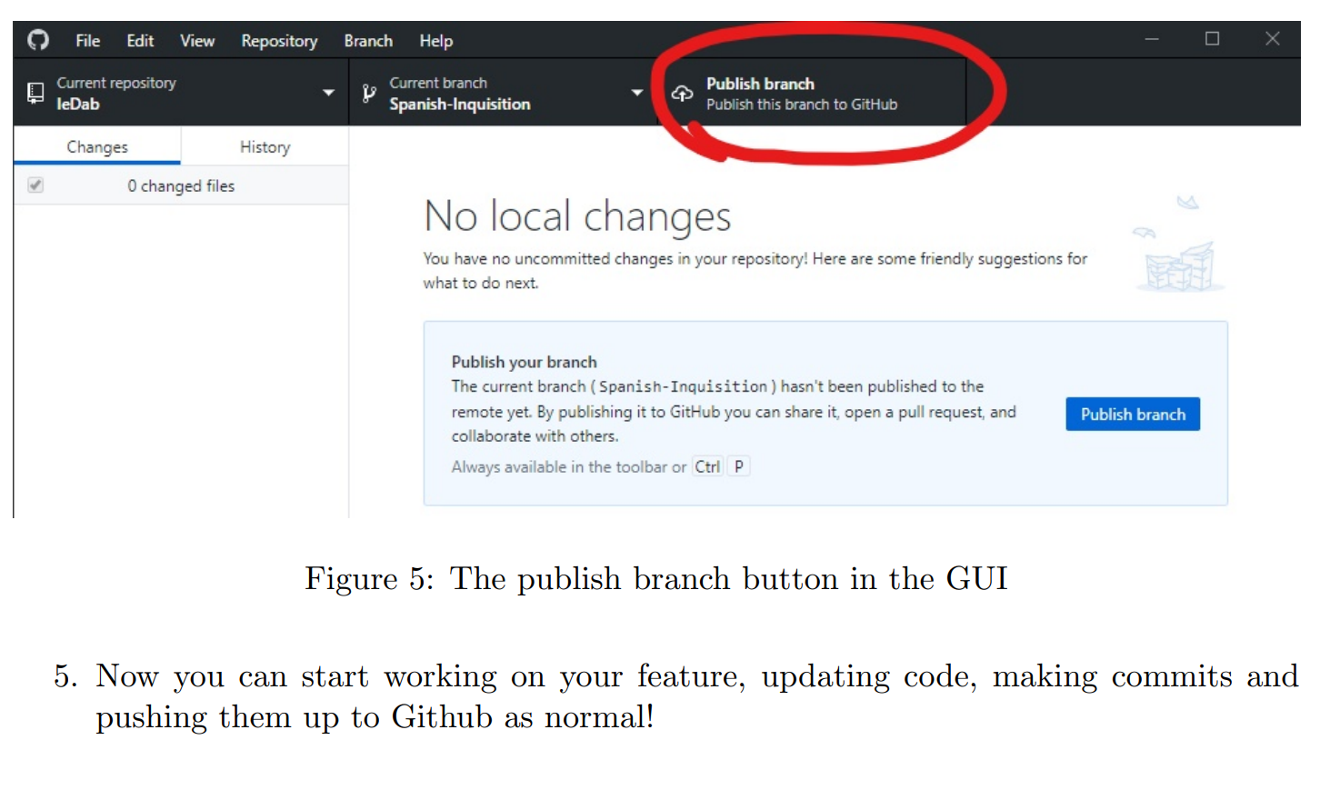
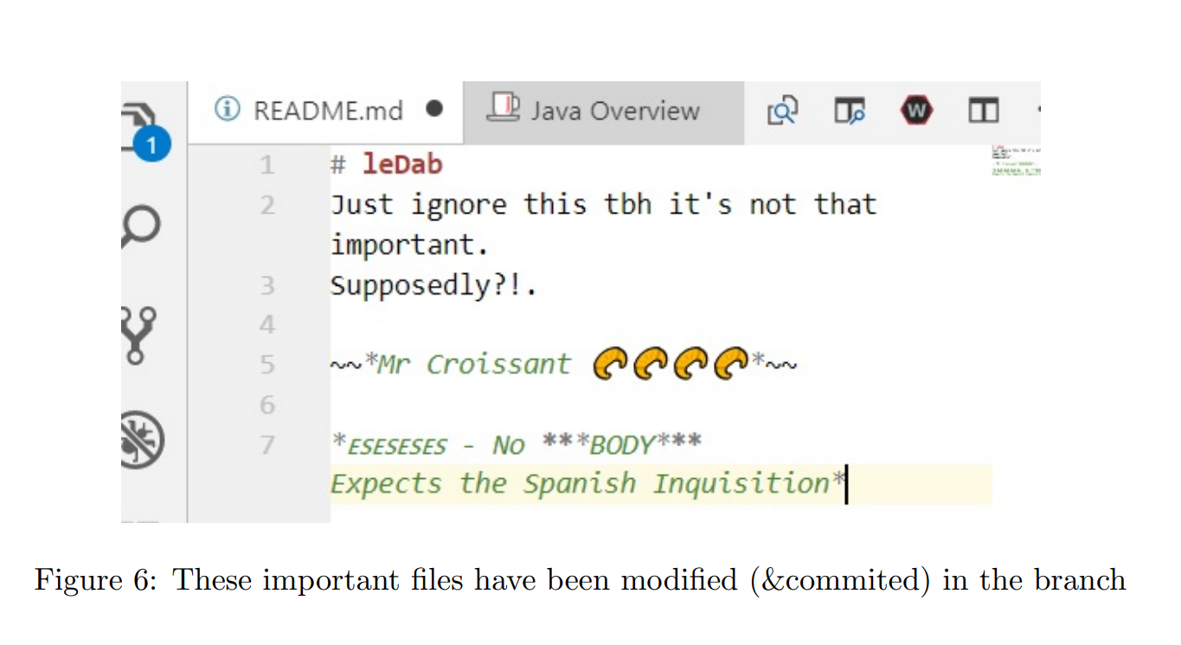

Slide 38
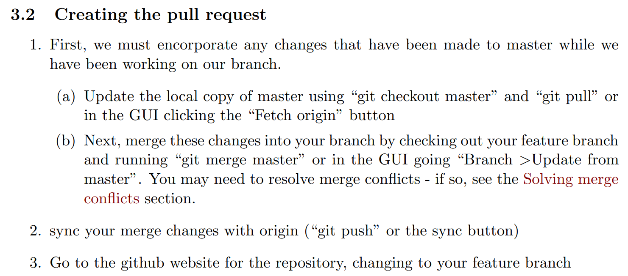
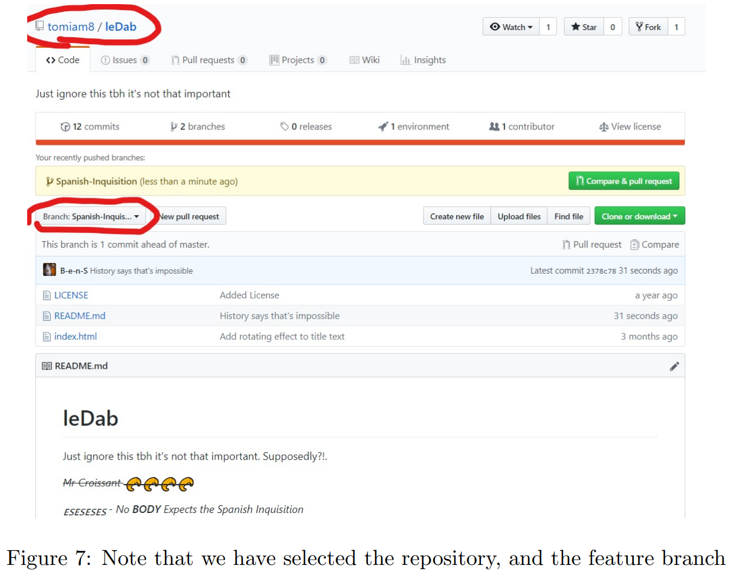

Slide 39
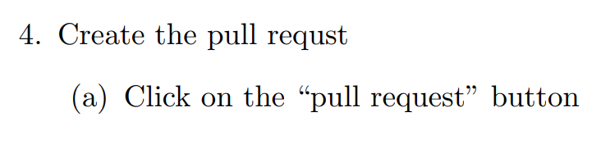
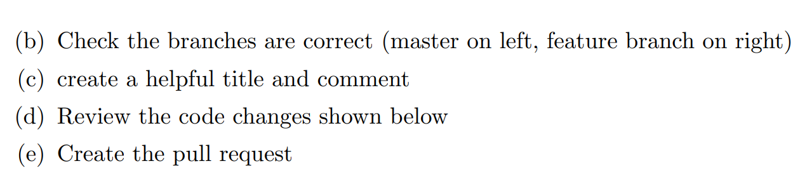
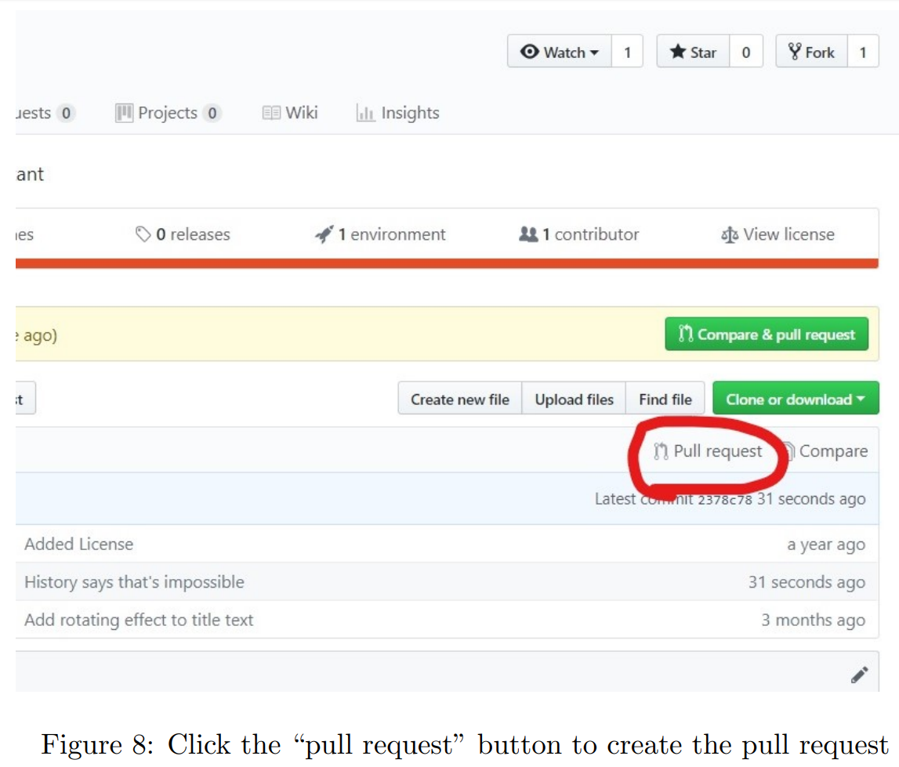

Slide 40
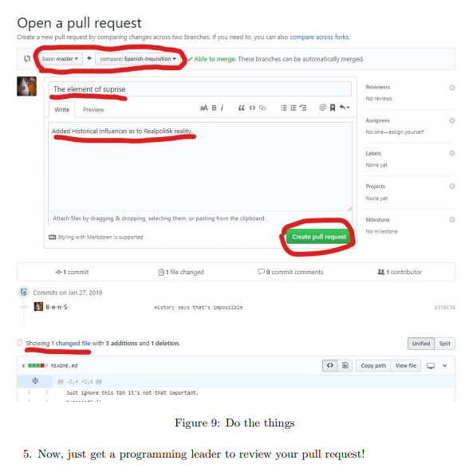

Slide 41
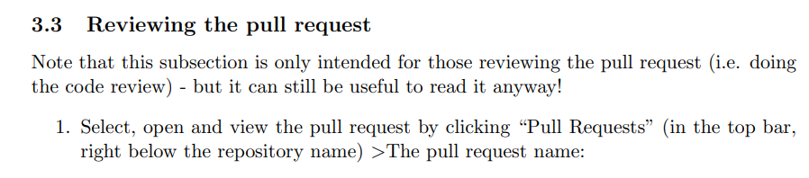
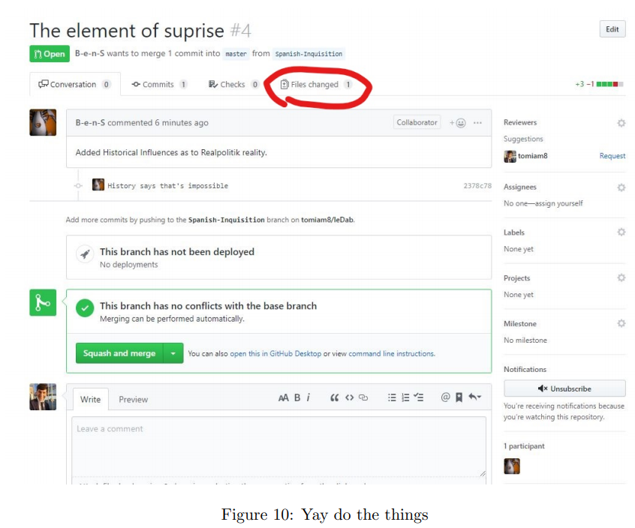

Slide 42
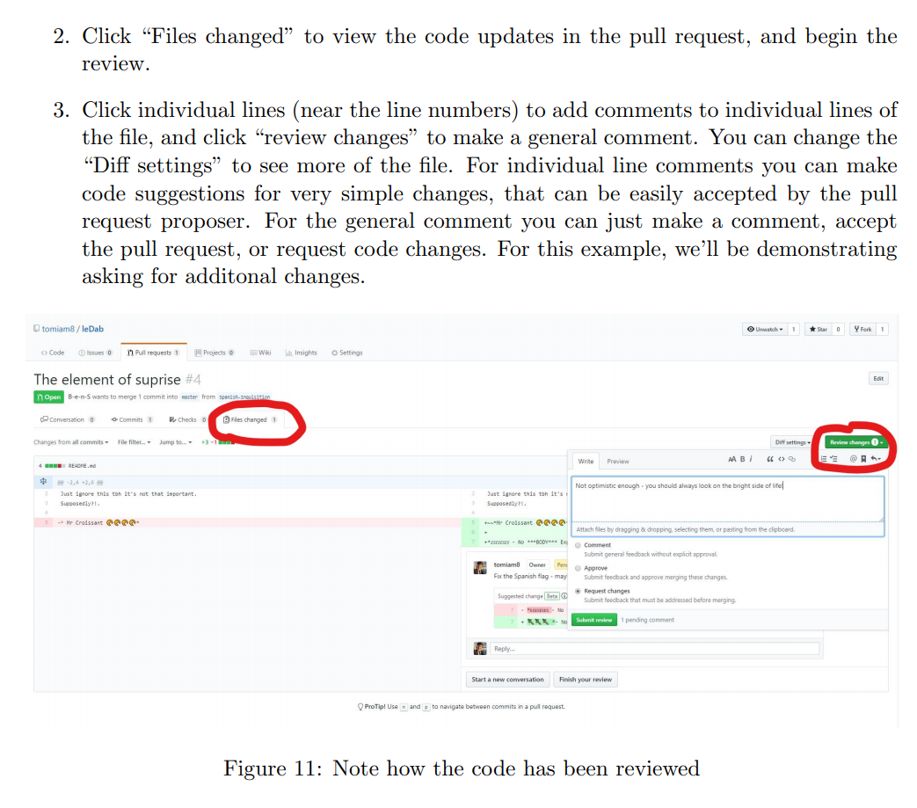

Slide 43
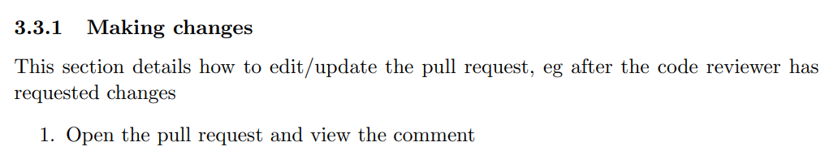
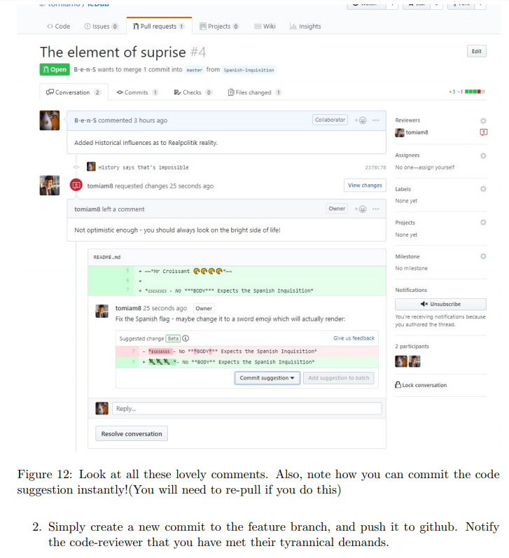

Slide 44
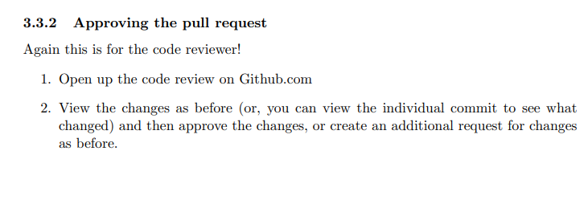
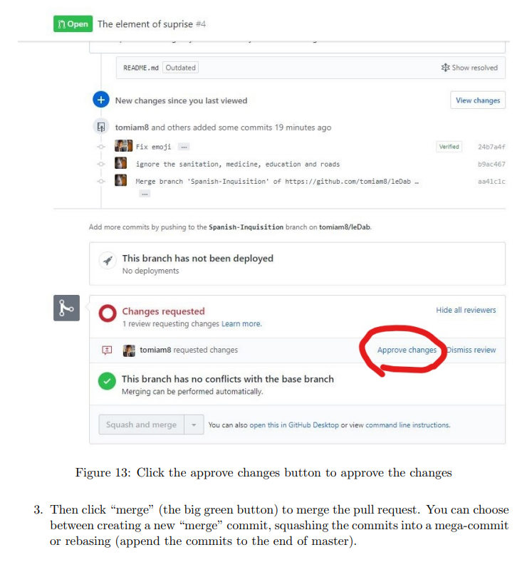

Slide 45
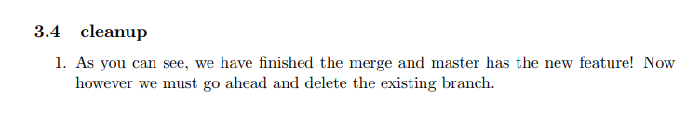
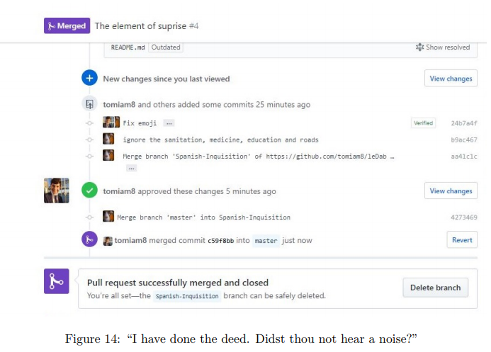

Slide 46
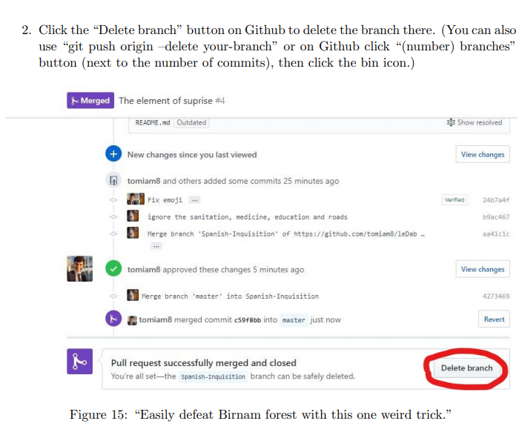

Slide 47
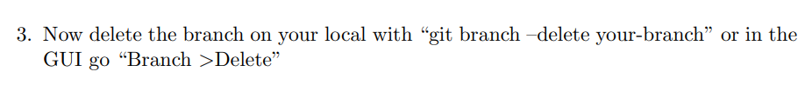
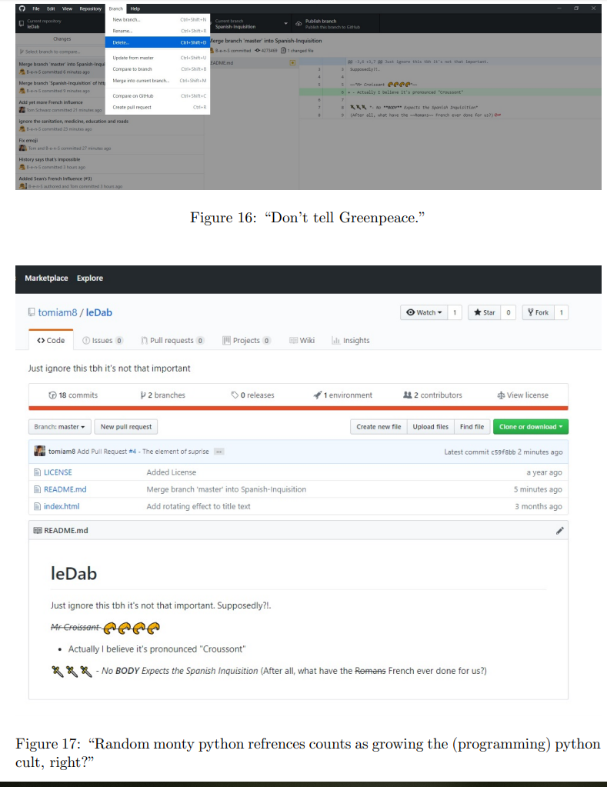

Slide 48
Lesson Summary:
You should now know what are:
VCSs
Repositories
Working Tree
Commits
Remotes
Fetching
Merging
Merge Conflicts
Pull Requests

